Slide 1
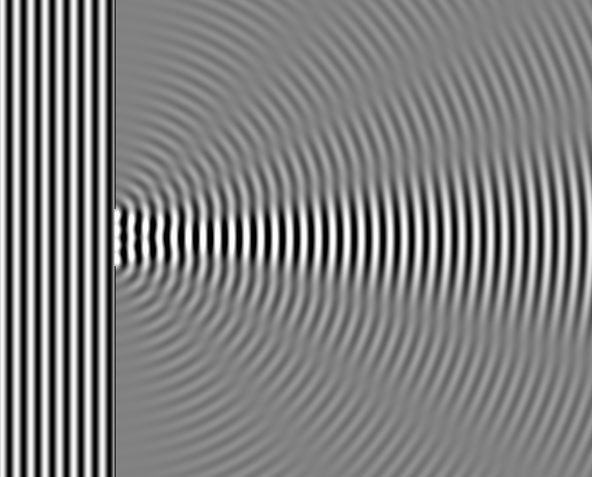
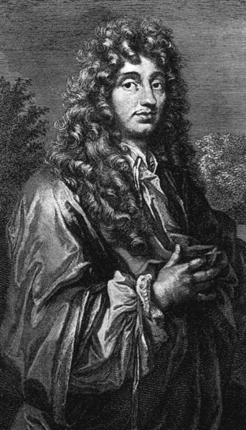
Refraction Seismology
Wavelets
Rule!
Snell’s Revenge!
Burger, Sheehan, Jones: Chapters 2.2, 3.1, 3.2, 3.3
Christiaan Huygens
(1629-1695)

Slide 2
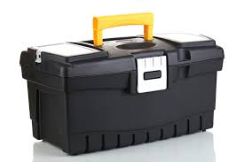
Our Geophysics Toolbox
Selecting the right geophysics tool depends on our target:
How deep? How big? What physical properties do we need to know? What do we already know? What is the resolution needed to solve our engineering/environmental/hazard problem?

Slide 3
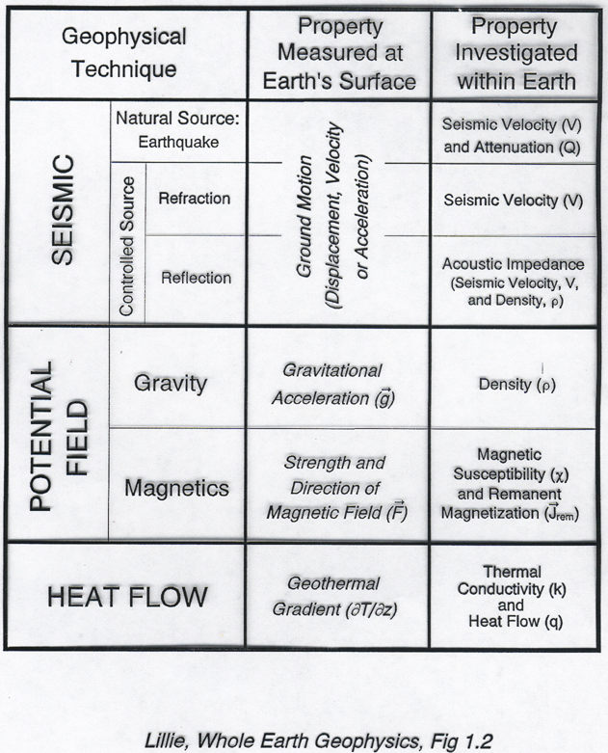
3-D seismic velocity
boundaries of many orientations
earthquake mechanics
Layer thickness, layer velocity
Horizontal boundaries
Layer thickness, velocity, contrast
Horiz boundaries, lateral transitions

Slide 4
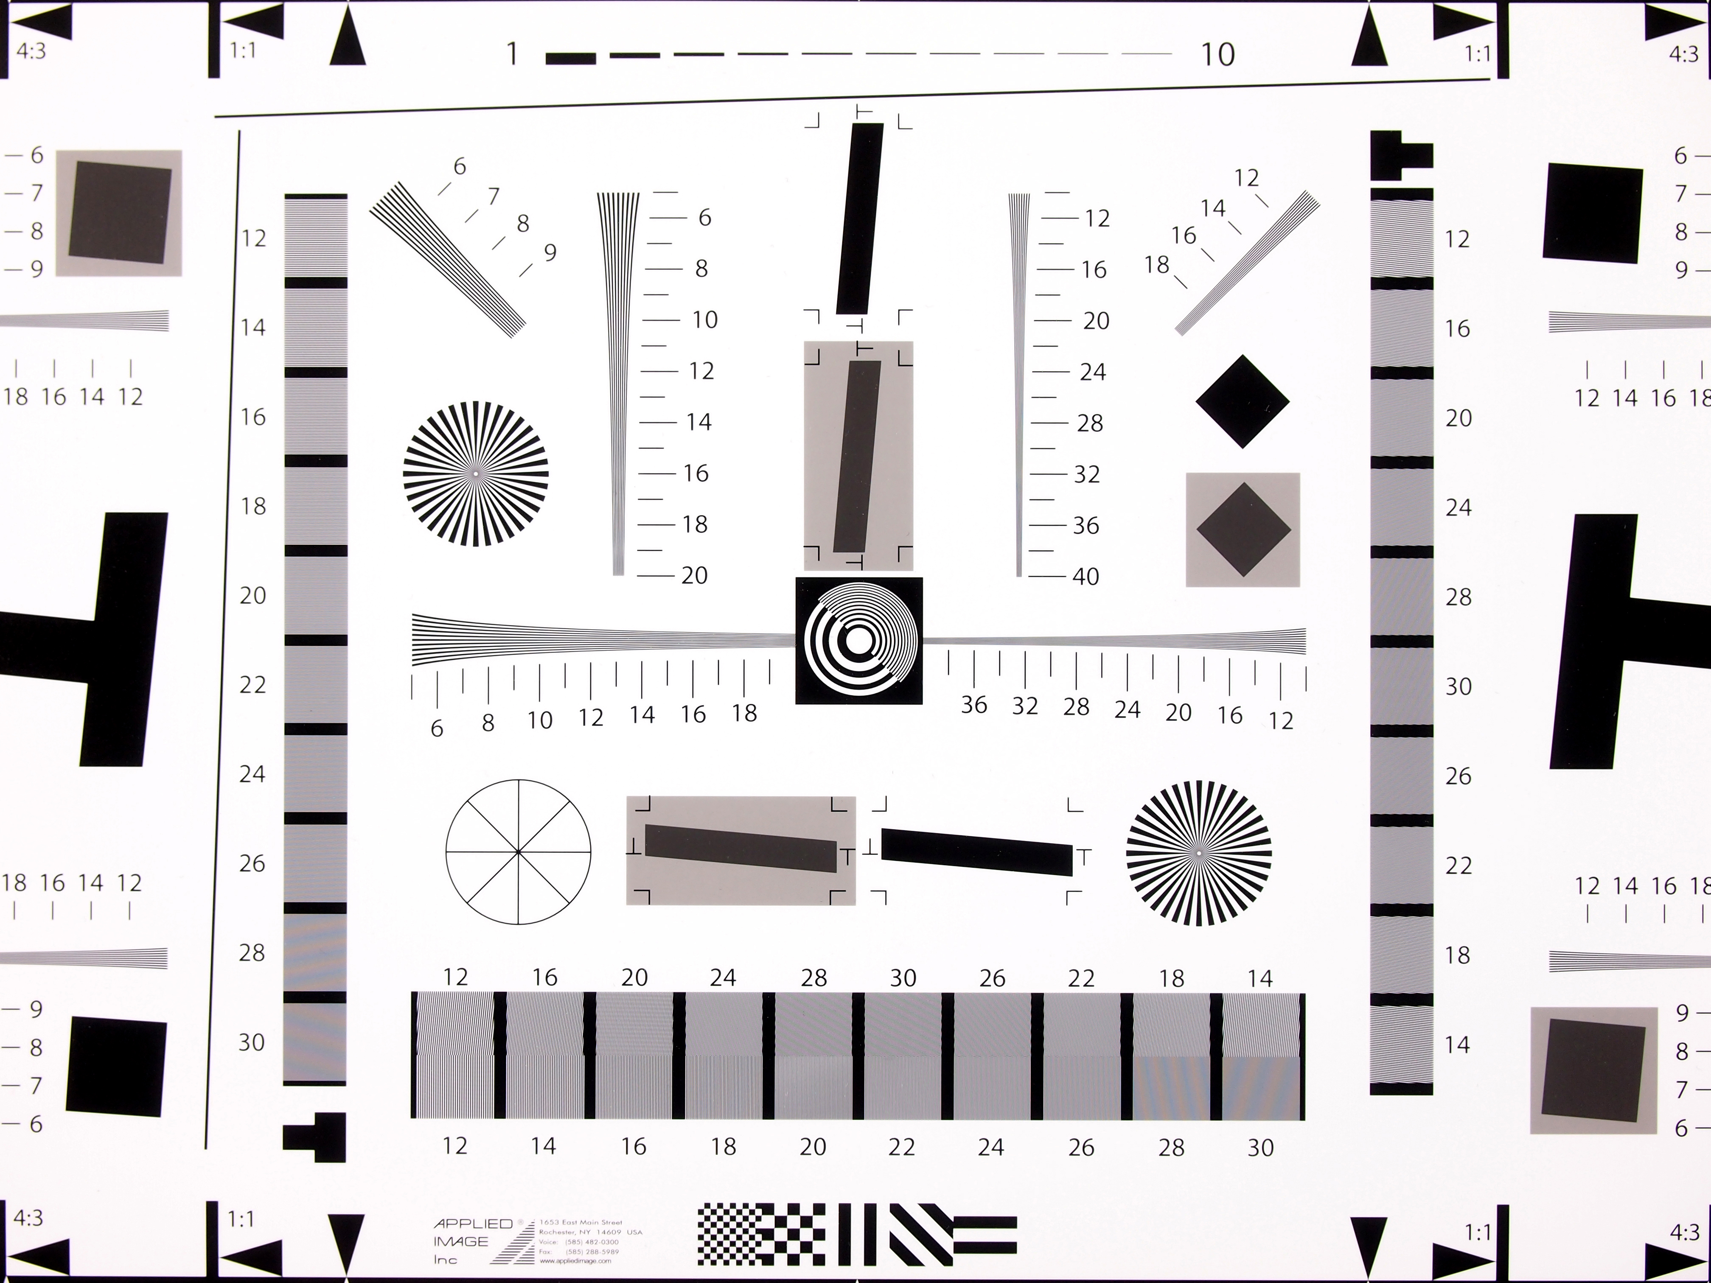
Resolution
Choosing the right tool—what do we need to resolve?
For seismology—vertical resolution is 0.25*wavelength
(wavelength=velocity/frequency)
Average P-wave crustal velocity: ~6000 m/s or 6 km/s
Frequencies: Earthquakes very broad range
- for 10 Hz waves, wavelength = 600 m
- for 1 Hz waves, about 6 km
Airguns: 3-900 Hz
Resolution chart for camera testing

Slide 5
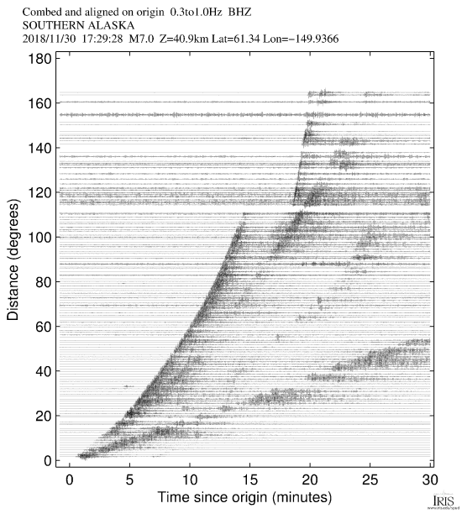

Slide 6
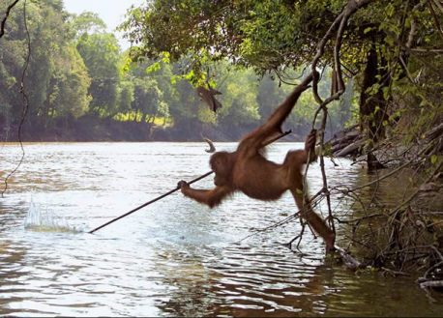
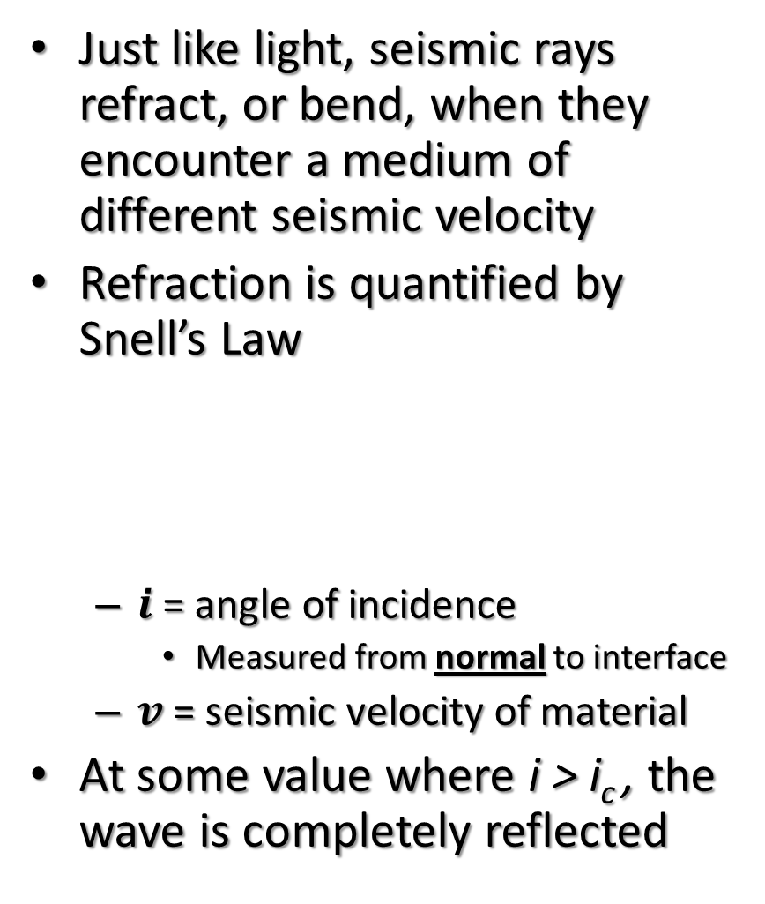
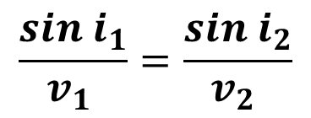
Finding Ray Paths :: Refraction
Just like light, seismic rays refract, or bend, when they encounter a medium of different seismic velocity
Refraction is quantified by Snell’s Law
$i$= angle of incidence
Measured from normal to interface
$v$ = seismic velocity of material
At some value where i > i_{c} , the wave is completely reflected
Curse you
Snell’s law!!
An orangutan spear fishing
$$\frac{sin{ i}_{1}}{v_{1} }=\frac{sin i_{2}}{v_{2} }$$
i₁
v₁
v₂
i₂
v₁ < v₂

Slide 7
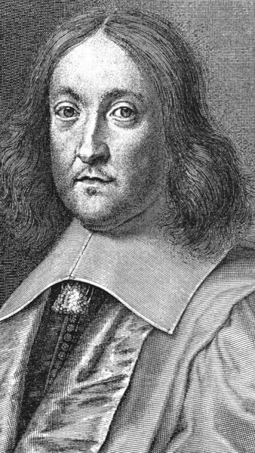
Fermat’s Principle
Pierre de Fermat (1601-1665): A French lawyer and amateur mathematician.
Fermat’s Principle: Light (and any wave, in general) travels in the path that takes the least amount of time between two points.
If velocity is uniform:
The path of least time is a straight line
If velocity is NOT uniform:
The path of least time is a not a straight line
The wave must bend or refract at the interface
A
A
V₁
V₂
B
B
*Assuming V₁ > V₂

Slide 8
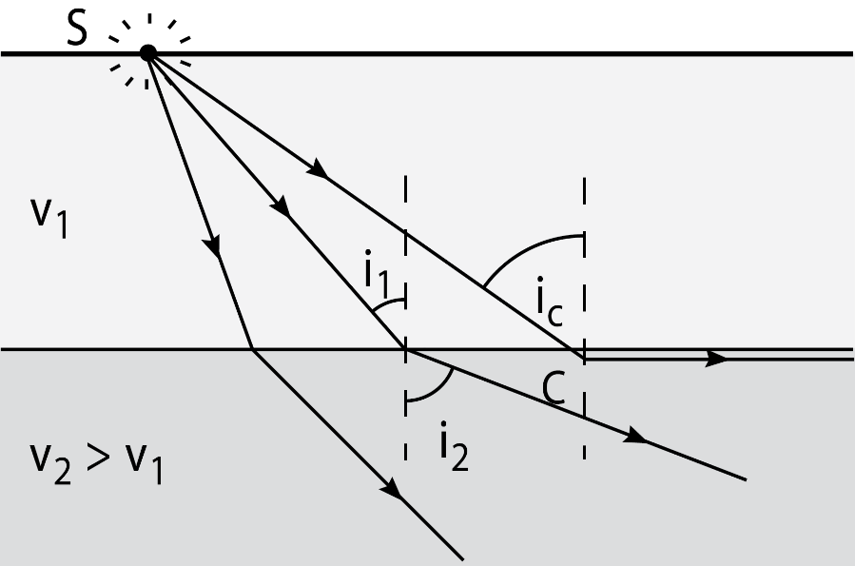
Snell’s Law & Critical Refraction
Seismic sources radiate waves in all directions
Some ray must hit interface at exactly the critical angle, i_{c}
This critically oriented ray will then travel along the interface between the two layers
If more oblique than critical, all wave energy is reflected
The reflected energy is useful too! And we’ll see it over the next couple weeks

Slide 9
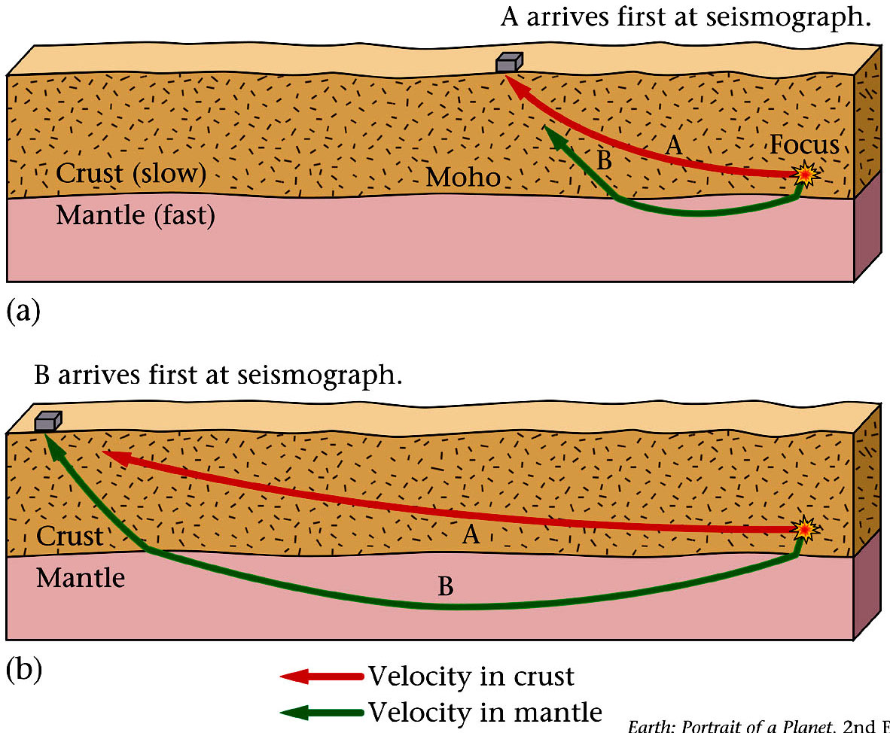
Refraction, Velocity and Arrival Times = Moho Discovery
Seismic waves travel faster through the mantle than the crust
In 1909, Andrija Mohorovičić discovered that waves first arriving at seismic stations within 200 km of an epicenter had an average velocity of 6 km/s
Stations > 200 km away
average wave speed 8 km/s
To explain this
nearby stations received waves that only went through the crust
far away stations received waves that travel through the mantle.
The crust mantle boundary is now called the Moho, in honor of this discovery

Slide 10

Potential Paths in a Refraction Survey
When doing a seismic refraction survey, a recorded ray can come from three main paths
The direct ray
The reflected ray
The refracted ray
Because these rays travel different distances and at different speeds, they arrive at different times
The direct ray and the refracted ray arrive in different order depending on distance from source and the velocity structure
Shot Point (i.e. the Source)
Receiver
Direct Ray
Refracted Ray
i_{c}
Reflected Ray
i_{c}
v₁
Layer 1
Layer 2
v₂
Why are these rays straight lines?

Slide 11
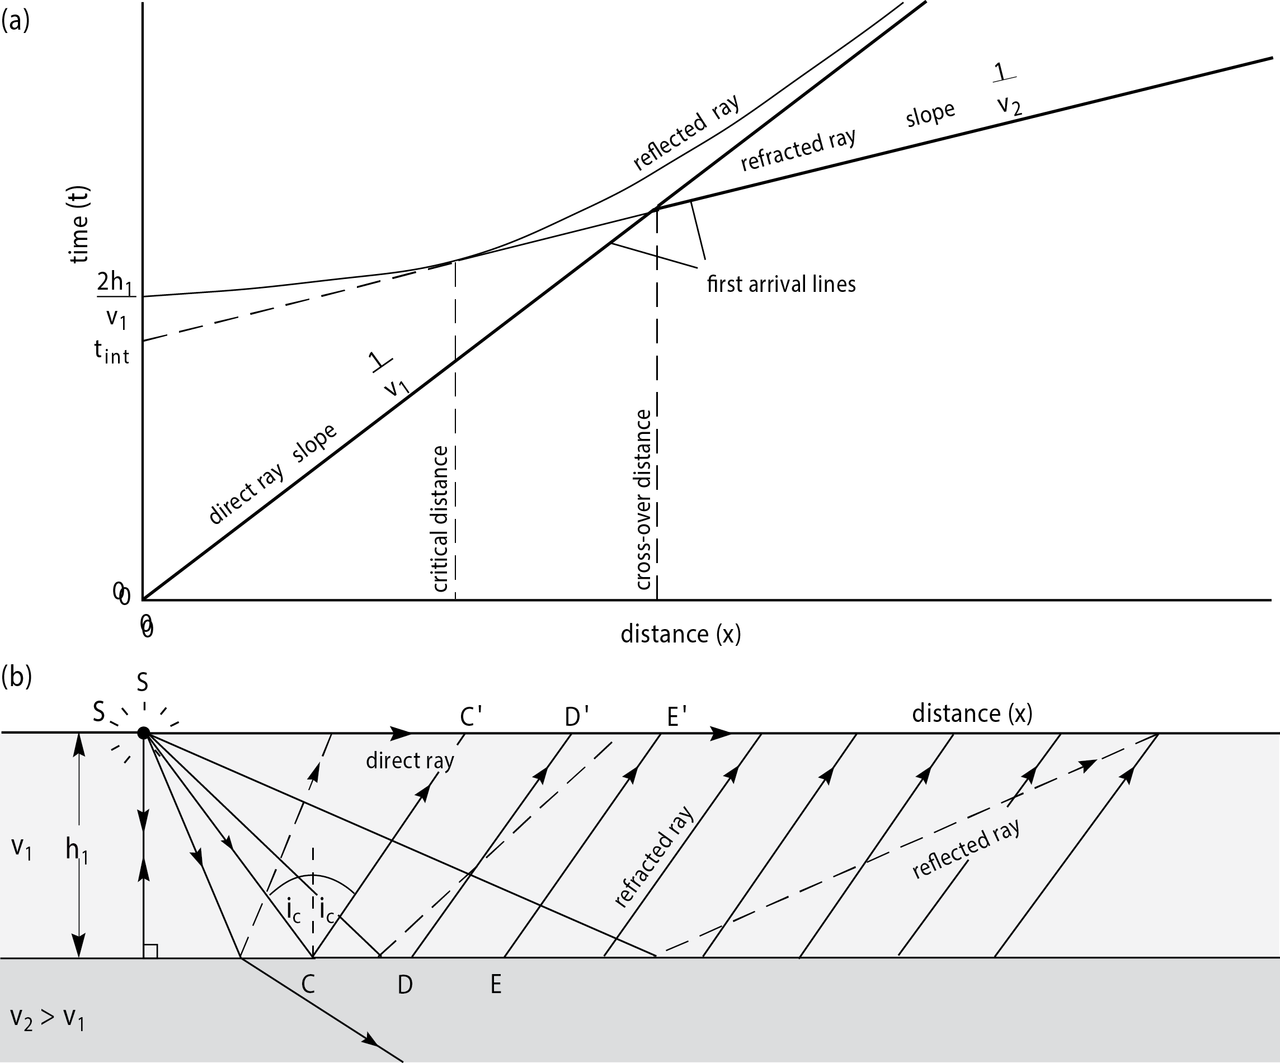
The Time-Distance (t-x) Diagram
Think about:
What would a fast velocity look like on this plot?
Why is direct ray a straight line?
Why must the direct ray plot start at the origin (0,0)?
Why is refracted ray straight line?
Why does refracted ray not start at origin?
Why does reflected ray start at origin?
Why is reflected ray asymptotic with direct ray?
Understanding The t-x Diagram is Key!!!

Slide 12
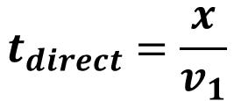
The Direct Ray
The Direct Ray Arrival Time:
Simply a linear function of the seismic velocity and the shot point to receiver distance
Time (t)
$$t_{direct}=\frac{x}{v_{1}}$$
Distance (x)
Shot Point
Receiver
Direct Ray
v₁
Layer 1
Layer 2
v₂

Slide 13
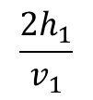
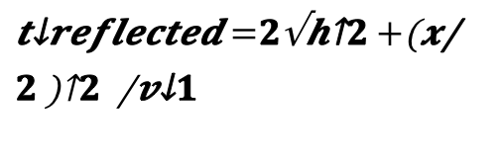
The Reflected Ray
The Reflected Ray Arrival Time:
is never a first arrival
Plots as a curved path on t-x diagram
Asymptotic with direct ray
Y-intercept (time) gives thickness
Why do we not use this to estimate layer thickness?
$$\frac{2h_{1}}{v_{1}}$$
Y-intercept
Time (t)
$t_{reflected}=2\frac{\sqrt{h^{2}+{\left(\frac{x}{2}\right)}^{2}}}{v_{1}}$
Distance (x)
Shot Point
Receiver
Layer 1
v₁
Layer 2
v₂

Slide 14
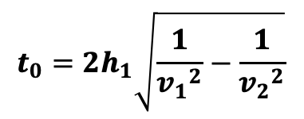
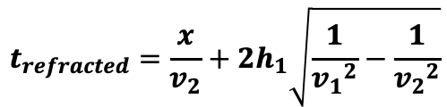
The Refracted Ray
The Refracted Ray Arrival Time:
Plots as a linear path on t-x diagram
Part travels in upper layer (constant)
Part travels in lower layer (function of x)
Only arrives after critical distance
Is first arrival only after crossover distance
Travels long enough in the faster layer
critical
distance
crossover
distance
Time (t)
$$t_{0}={2h}_{1}\sqrt{\frac{1}{{v_{1}}^{2}}−\frac{1}{{v_{2}}^{2}}}$$
“Critical Distance”
No Refracted Rays →
$$t_{refracted}=\frac{x}{v_{2}}+{2h}_{1}\sqrt{\frac{1}{{v_{1}}^{2}}−\frac{1}{{v_{2}}^{2}}}$$
Distance (x)
i_{c}
i_{c}
i_{c}
i_{c}
v₁
Layer 1
Layer 2
v₂

Slide 15
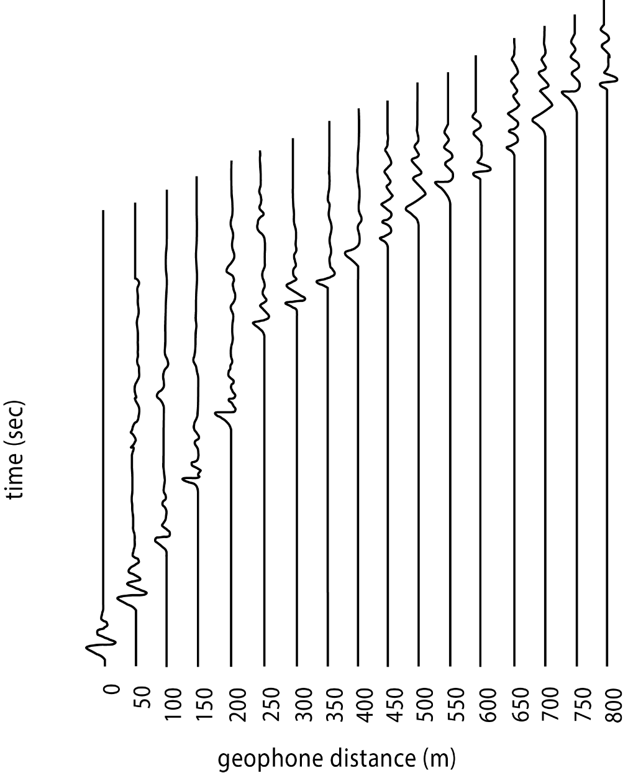
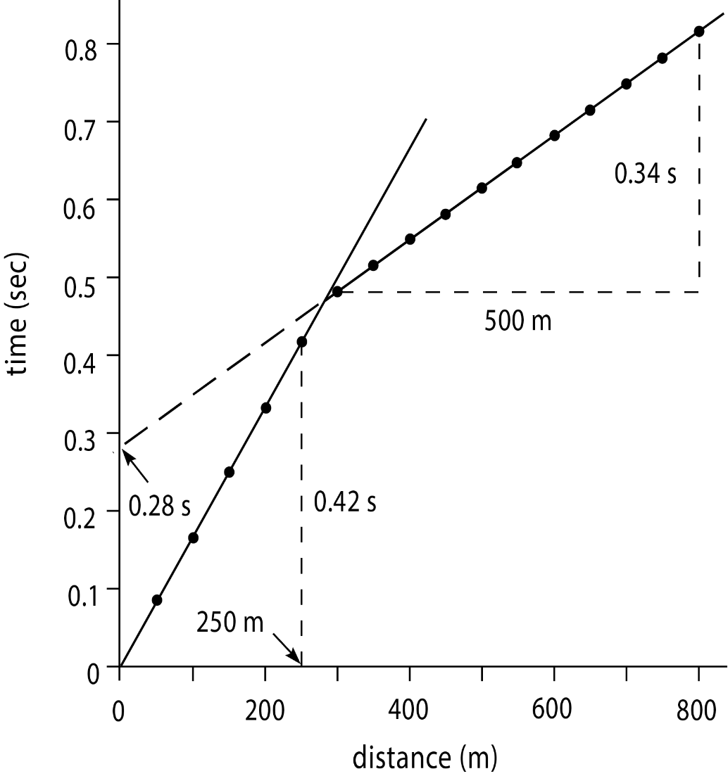
Making a t-x Diagram
Refracted Ray Arrival Time, t
or
Y-intercept to find thickness, h₁
v₂ = 1/slope
v₁ = 1/slope

Slide 17
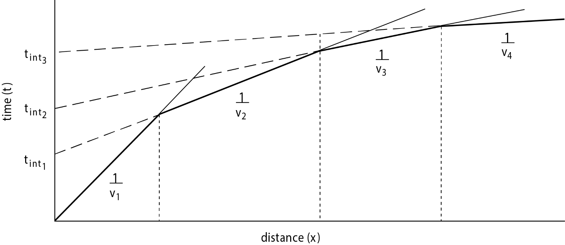
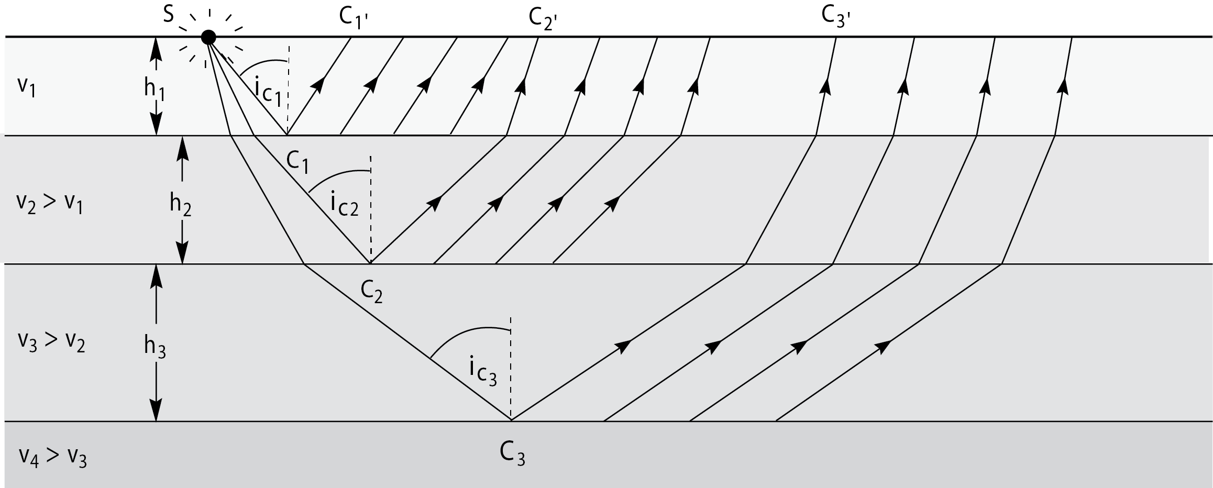
Multiple Layers
Seismic refraction can detect multiple layers
The velocities are easily found from the slopes on the t-x diagram

Slide 18
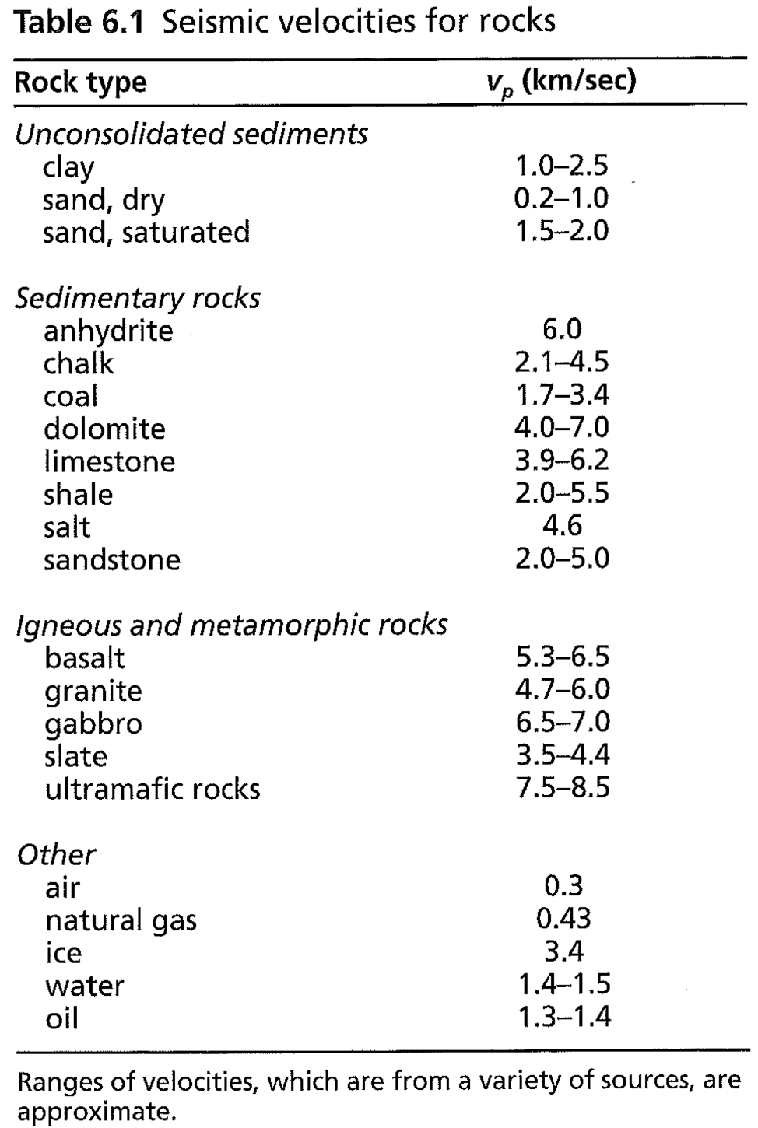
Refraction…What is it Good For?
Seismic refraction surveys reveal two main pieces of information
Velocity structure
Used to infer rock type
Depth to interface
Lithology change
Water table

Slide 19
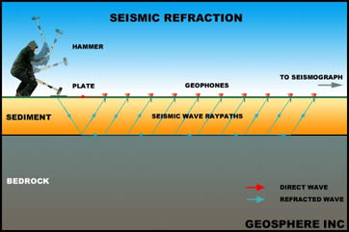
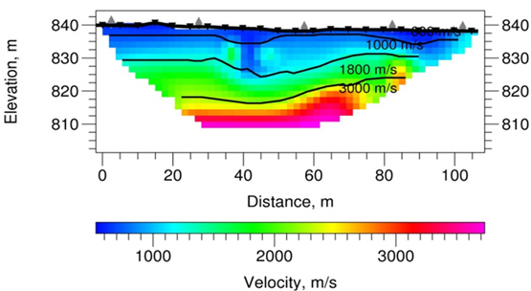
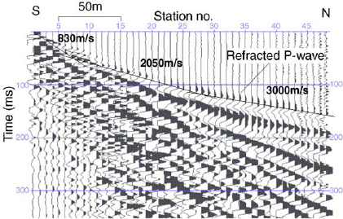
Applications – saturated rock, depth to bedrock, degree of weathering

Slide 20
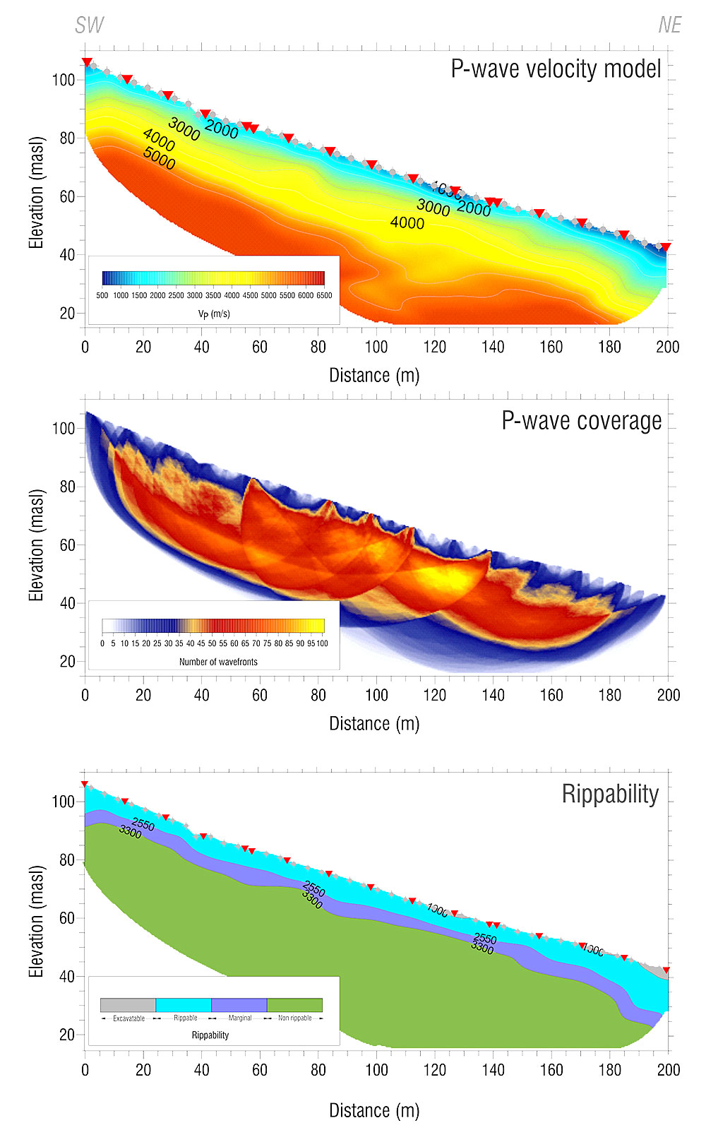
Applications – Geotechnical/engineering
Rippability measures the degree of difficulty to excavate any given soil or rock
It is a significant aspect of the preliminary work of any civil engineering project

Slide 21
Socorro Data using SeisImager2D
Ian Podmore

Slide 22
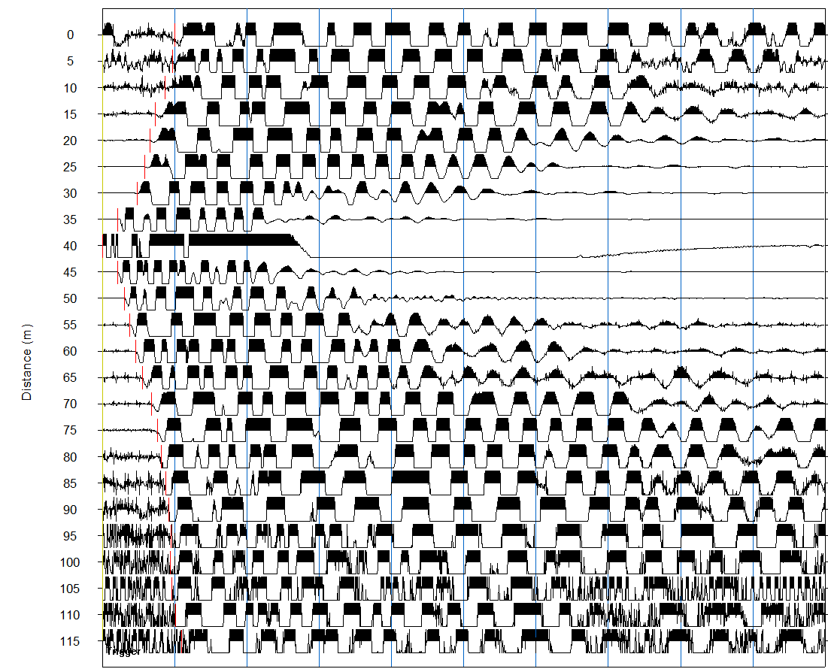
Picking 1st Arrivals
Process was done in SeisImager’s Pickwin software
Set geophone offset and shot location manually
Pick first arrival for each geophone, then repeat process for all 24 shot gathers
Raw data looks better than stacked waveforms in most cases

Slide 23
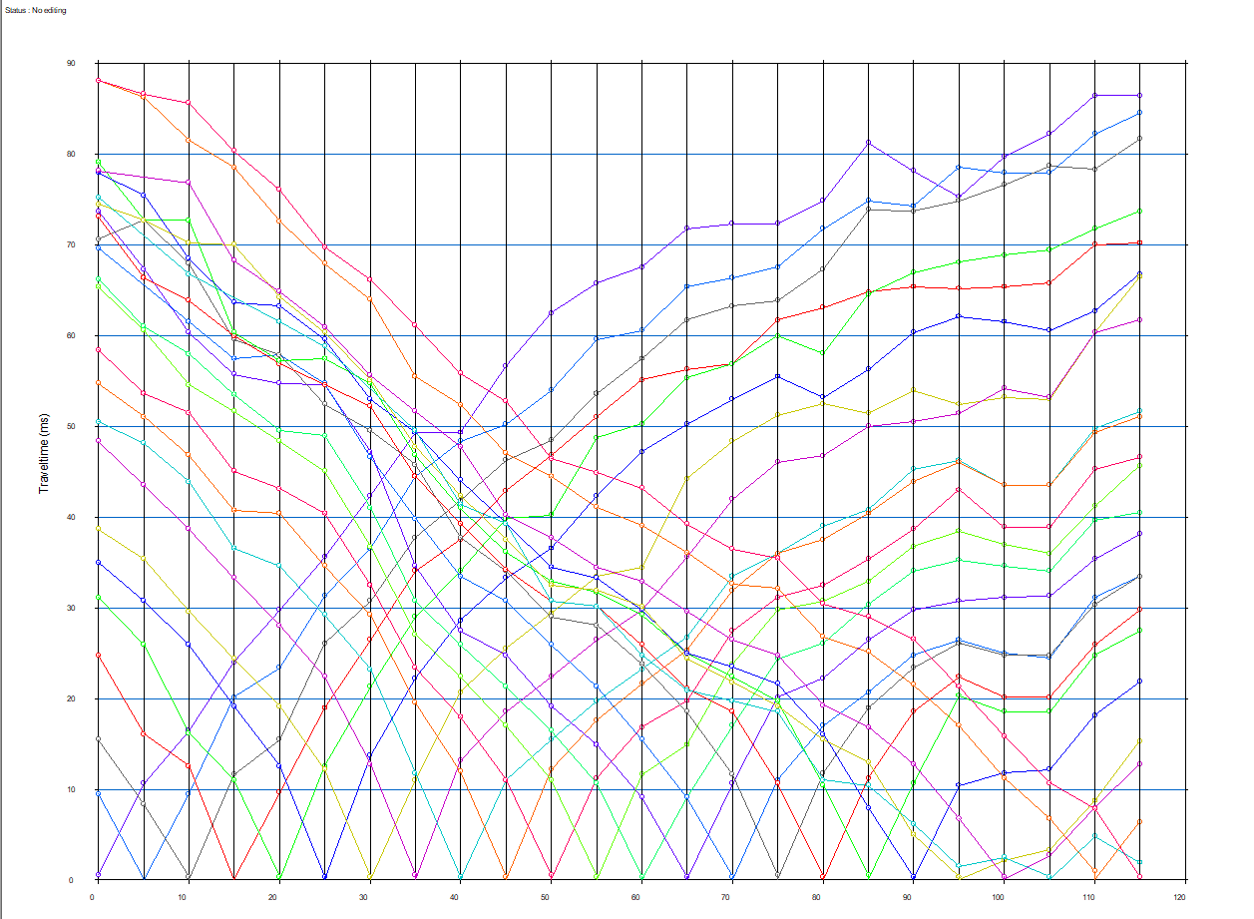
Travel Time Curves
1 layer interpretation
Once all shots have 1st arrivals picked, import data to Plotrefa software
Plotrefa offers 2 options: 2-layer model and 3-layer model
We also tricked it into a 1-layer model

Slide 24
Travel Time Curves
2 layer interpretation
Once all shots have 1st arrivals picked, import data to Plotrefa software
Plotrefa offers 2 options: 2-layer model and 3-layer model
We also tricked it into a 1-layer model

Slide 25
Travel Time Curves
3 layer interpretation
Once all shots have 1st arrivals picked, import data to Plotrefa software
Plotrefa offers 2 options: 2-layer model and 3-layer model
We also tricked it into a 1-layer model

Slide 26
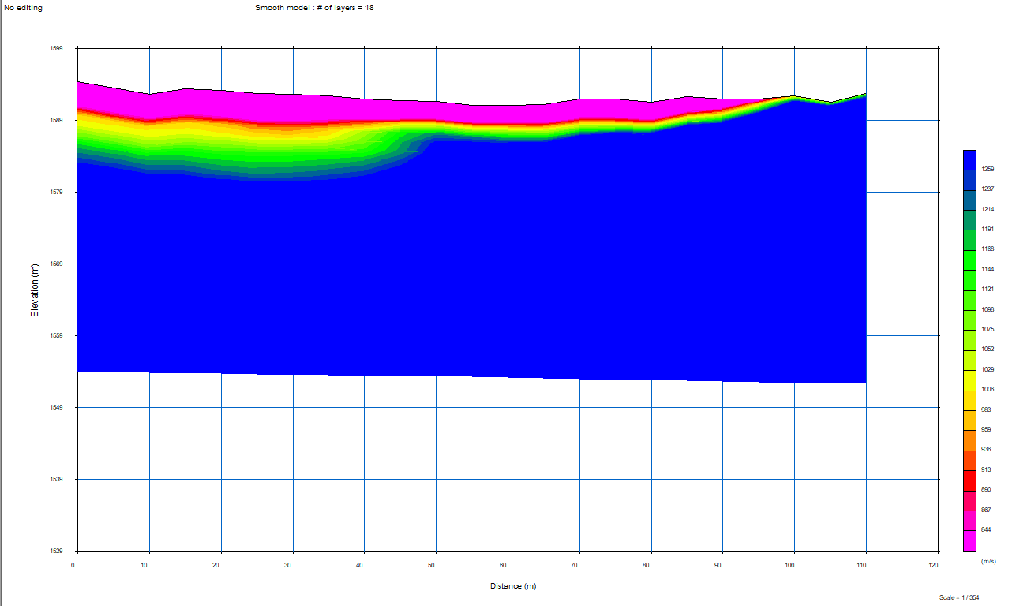
1 layer inversion

Slide 27
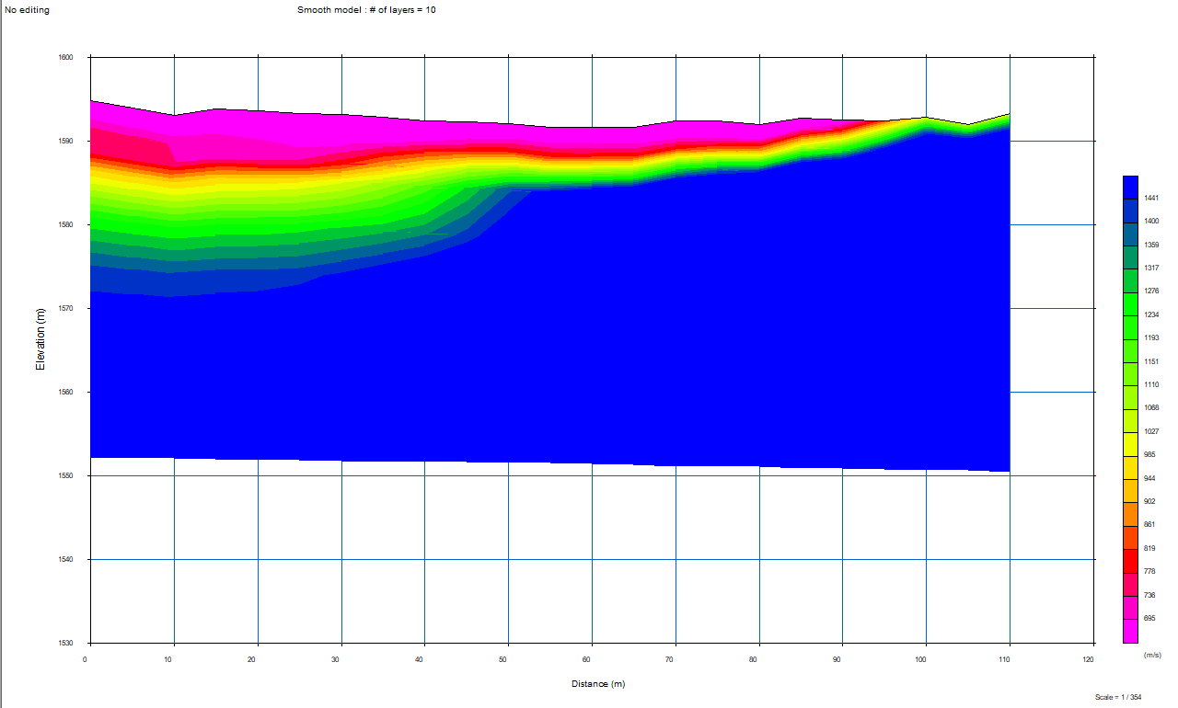
2 layer inversion

Slide 28
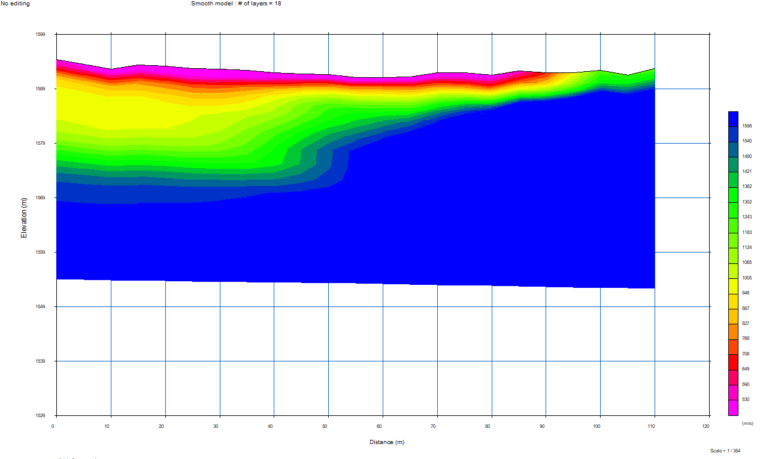
3 layer inversion

